Slide 1
"Wearable Technology in Monitoring Late Pregnancy: Breakthroughs and Challenges"
Group 27
Junnan Liu 201715540
Zhu Zhu 201388759
Yifeng Chen 201769378
Longfei Zou 201777135

Slide 2
Index
01. An example-Bloomlife
02. Data
03. Options for additional sensors
04. Limitations and Critical aspects

Slide 3
01
An example-Bloomlife
An example of an available product on the market that allows for the monitoring of pregnant women in the third trimester of pregnancy

Slide 4
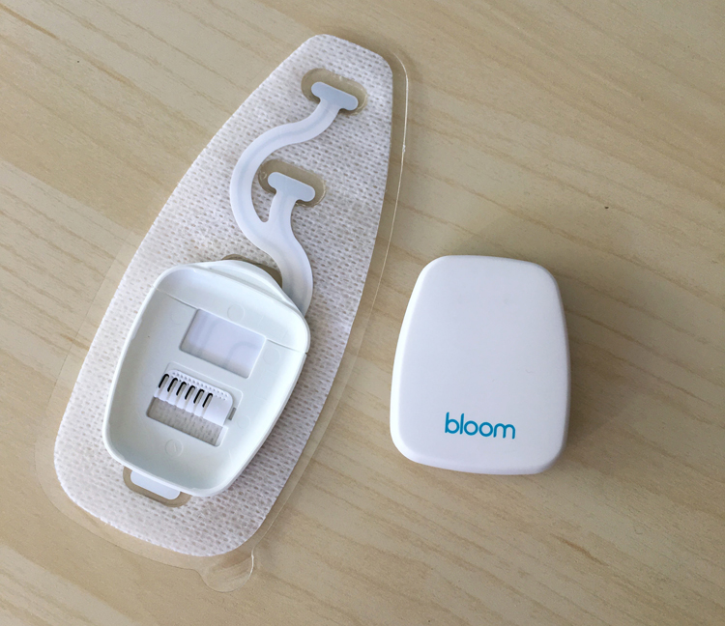
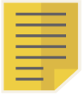
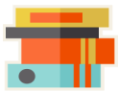


An example
Bloomlife
Aim
designed to monitor and evaluate maternal and fetal health continuously
FDA-cleared
Features
Remote patient monitoring,
Digital health screening,
Comprehensive data analytics
Benefits
Reducing the need for frequent in-person visits and improving the overall quality of care.
Notes:
Bloomlife is a good example of a product on market that follow for the monitoring of pregnant women in the third trimester of pregnancy.
It's specifically designed to monitor and evaluate maternal and fetal health continuously, which is crucial during late pregnancy.
The device is FDA-cleared, highlighting its reliability and effectiveness.
features：remote patient monitoring, digital health screening, and comprehensive data analytics
benefits：reducing the need for frequent in-person visits and improving the overall quality of care.
The system works by sending smart notifications based on clinical protocols, which helps in quickly identifying any necessary interventions for the mother's and baby's health. Furthermore, the device is designed to integrate easily into existing workflows, making it convenient for both healthcare providers and expectant mothers

Slide 5
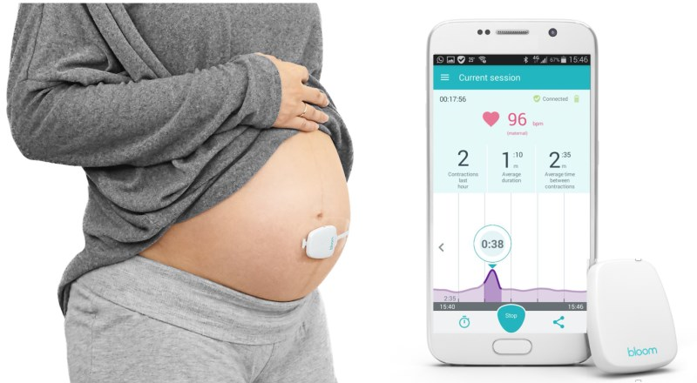
Bloomlife
Fits Into Existing Workflows-Simplifying the Maternal Care Journey
04
01
High-Risk Diagnosis
Home Monitoring Made Easy
No setup required. Bloomlife Connects works right out of the box delivering daily patients reminders, automatic data transmission, and real-time patient feedback for peace of mind
Using existing clinical guidelines, OB/GYNs identify high risk patients who require additional screening and clinical management.
02
Prescribe Bloomlife Connects
OB/GYNs prescribe Bloomlife Connects based on clinical risk factors directly from their EMR.
05
Real-Time Clinical Oversight
Based on fully configurable clinical protocols, care teams are notified when you want, how you want to more easily and earlier identify at risk moms.
【1】
03
Patient Enrollment & Onboarding
【2】
FDA cleared cellular enabled connected devices are conveniently shipped to the patient’s home and Bloomlife completes education and onboarding.
Notes:
Bloomlife simplifies the maternal care journey and to meet the needs of pregnant women, the following five steps are necessary
01. High-Risk Diagnosis
Using existing clinical guidelines, OB/GYNs identify high risk patients who require additional screening and clinical management.
02.Prescribe Bloomlife Connects
OB/GYNs prescribe Bloomlife Connects based on clinical risk factors directly from their EMR.
03.Patient Enrollment & Onboarding
FDA cleared cellular enabled connected devices are conveniently shipped to the patient’s home and Bloomlife completes education and onboarding.
04.Home Monitoring Made Easy
No setup required. Bloomlife Connects works right out of the box delivering daily patients reminders, automatic data transmission, and real-time patient feedback for peace of mind.
05.Real-Time Clinical Oversight
Based on fully configurable clinical protocols, care teams are notified when you want, how you want to more easily and earlier identify at risk moms.

Slide 6
02
Data
Which data could be useful to evaluate the health status of the mother and the development of the foetus?

Slide 7

Data
Heart Rate and Rhythm
Importance: Provides insights into health and stress levels.
Details: Variations reflect fetal well-being.
Blood Pressure
Importance: identifying and managing hypertension disorders
Uterine Contractions
Purpose: Helps assess labor progress and determine the need for intervention.
Metrics Monitored: Frequency, duration, and intensity.
Temperature
Usage: maternal health and inflammatory state.
Types Monitored: Core and peripheral temperatures.
Notes:
1. Heart Rate and Rhythm: Monitoring the heart rates of both mother and fetus can provide important insights into their health and stress levels. Variations in fetal heart rate can be indicative of fetal well-being.
2. Blood Pressure: Monitoring blood pressure in pregnant women is crucial for the early identification and management of pregnancy-induced hypertension disorders such as preeclampsia.
3. Uterine Contractions: By monitoring the frequency, duration, and intensity of contractions, healthcare providers can assess the progress of labor and intervene when necessary.
4. Temperature: Monitoring the core and peripheral temperature of the mother helps assess her overall health and inflammatory state.

Slide 8
Data
5. Oxygen Saturation
Goal: oxygen supply
6. Activity and Position Monitoring
Method: Uses accelerometers
Impact: activities and positions
7. Biochemical Markers
Sources: Blood and urine samples.
Markers Include: Glucose levels, proteins, hormone levels.
Purpose: Evaluates nutritional and metabolic health.
Notes:
5. Oxygen Saturation: Monitoring blood oxygen levels helps ensure that both the mother and fetus are receiving sufficient oxygen.
6. Monitoring a pregnant woman's activity level and positional changes through accelerometers can gather data about how her daily activities and body positions might affect the fetus.
7. Biochemical markers measured through blood and urine samples (such as glucose levels, proteins, and hormone levels) can assess the nutritional and metabolic health of the pregnant woman

Slide 9
03
Options for additional sensors
Notes:
Next, I will demonstrate the third part. This part mainly talks about Options for additional sensors. Which means What additional sensors can we integrate with this device to improve efficiency or add additional relevant parameters?

Slide 10
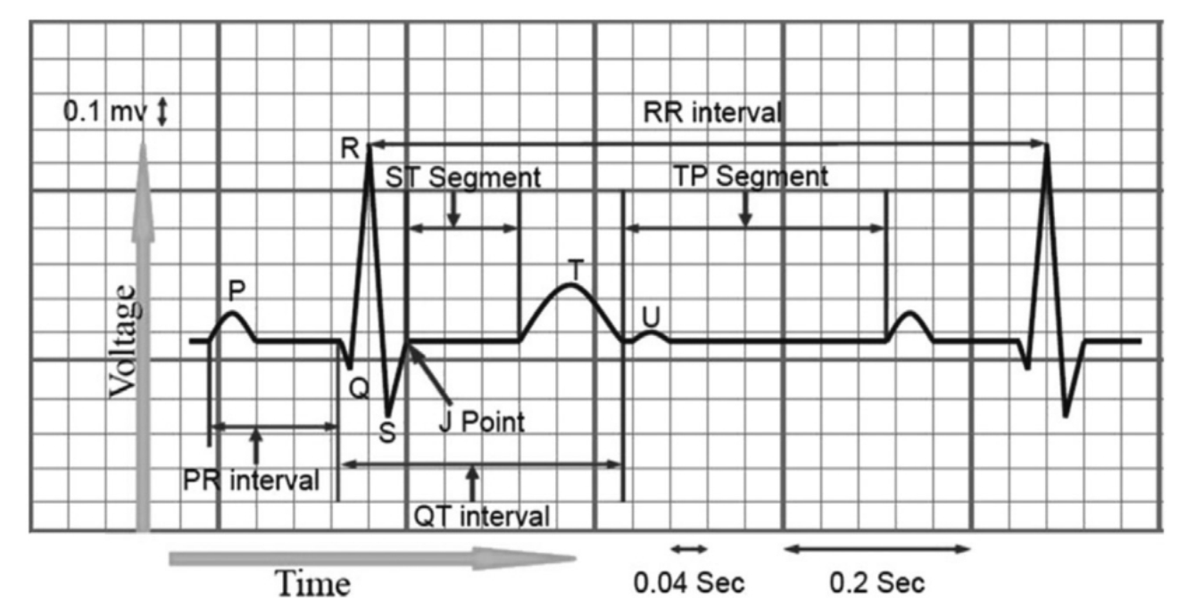
Electrocardiogram (ECG sensor)
Introduction & Data type to be tested
It can measure more than just heart rate！
Figure1. Electrocardiogram
Notes:
Since the heart rate generally increases during pregnancy, most devices on the market monitor the heart rate of pregnant women in real time to prevent heart-related diseases, but few of them go further to analyze the electrocardiogram to diagnose possible problems.
For example, in the picture below (pointing to the electrocardiogram), multiple papers show that the QRS angle, T-axis assignment, PR interval and QT interval all increase to varying degrees during pregnancy, so the possibility of them becoming abnormal increases accordingly.
The values we need to measure include QRS axis phase and T axis phase.

Slide 11

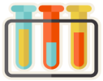


Electrocardiogram (ECG sensor)
Normal range & Reliability
VALUE
01
Phase angle on the QRS-axis
02
Normal Range：38° ± 22°
Reliability： r=-0.32,p<0.001
Sensitivity：
Time: ms
phase angle : degree
Phase angle on the T-axis
Normal Range：22° ± 16°
Reliability：r=-0.28,p<0.001
Sensitivity：
Time: ms
Phase Angle : degree
03
04
Abnormal Situation
05
QRS > -30° ：
Change in heart position
Left anterior fascicle block
Left ventricular hypertrophy
Notes:
According to the paper, we can know that the values that need to be measured first include QRS axis phase and T axis phase. （右上）The QRS range is approximately 38°±22°. Relevant research shows that the correlation coefficient of this value is -0.32, and the significance level is less than 0.001, indicating that the negative correlation between QRS and body mass index is very relevant, and the range of T is approximately 22°±16°, the correlation coefficient of this value is -0.28（左）, and the significance level is less than 0.001, indicating that the relationship between T and body mass index Negative correlations are very relevant. When these ranges are exceeded, especially when the QRS is less than -30°, there is conclusive evidence that there may be symptoms such as changes in heart position, left anterior fascicle block, or left ventricular hypertrophy.

Slide 12




Hormone Level Sensor
Introduction
Female hormones have a great impact on women’s health
Female hormones have a great impact on women’s health
Can detect depression
Quantitative analysis requires mass spectrometry and immunoassays
Invasive blood draws are not good for pregnant women
Notes:
Next we can also add a female hormone sensor. （红色）Estradiol is the main form of the female hormone estrogen, and it is also the most effective and common female hormone during the childbearing age, (蓝)it can also detect the depression. In previous years, this value could only be detected by drawing blood or using large-scale equipment. It was not until this year that a paper proposed a non-invasive automatic sensor for monitoring ethylene glycol in women. It has ultra-high sensitivity and ultra-low detection limit.

Slide 13
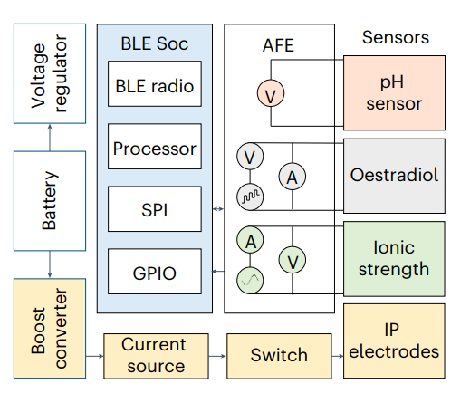
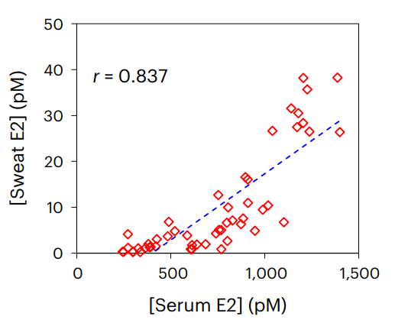
Hormone Level Sensor
Normal range & Reliability
Hormone Concentration
Normal Range：25-200pm
Reliability ： r=0.837
Sensitivity：
Current: nA
Density : pm
Figure4. Equipment architecture diagram
Figure5. Correlation between hormone levels in blood and sweat of pregnant women
Notes:
Although the correlation coefficient between estradiol levels in sweat and in blood is as high as 0.837, variations in sweat composition among different pregnant women may lead to inaccuracies in estradiol measurements. Therefore, it is necessary to measure the pH and temperature of pregnant women to correct the measurement of estradiol (as shown in the left figure). This requires pH sensors and temperature sensors. Additionally, according to the Nernst equation, we can calculate the concentration of estradiol corresponding to changes in electrical potential. The normal range is 25-200 pm.

Slide 14
Hormone Level Sensor
Adverse reactions
Hormone Concentration
Hormone Concentration
<25pm
>200pm
Pregnancy-related depression or mood swings
Fetal growth restriction
Pregnancy-induced hypertension
Pregnancy-induced high blood pressure disorder
Increased risk of preterm birth
Increased risk of threatened miscarriage or miscarriage
Notes:
In pregnant women, changes in estradiol levels may have effects on the mother and fetus. In pregnant women, abnormal estradiol levels usually cause the following symptoms and effects: When it is less than 25pm, estrogen is too low, which may lead to depression or Fetal growth restriction. When it is greater than 200pm, estrogen is too high. If it is too high, it may lead to high blood pressure or premature birth. Therefore, monitoring of estrogen is necessary.

Slide 15
04
Limitations and Critical aspects

Slide 16

Introduction
Constraints and key factors
Wearable activity trackers are now widely used to track daily activities, especially to monitor sports performance, but also to continuously assess the physical condition of a specific patient, but various problems can arise during use.
Application Scenarios
Sensor positioning
Equipment conflicts
Other cases
Ethical concerns

Slide 17
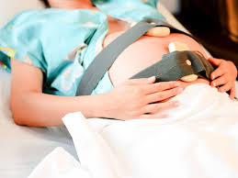

Specific situation and solutions
01
Sensor Positioning
Limitation: Accurate data collection depends on correct placement of the device. Improper targeting can result in inaccurate or incomplete data, resulting in false positives or false negatives.
Critical Aspect: Clear instructions, training, or assistance with correct placement are essential to ensure reliable and accurate data collection.
02
Application Scenarios
Limitation: Not all pregnancies are the same, and specific conditions may require specialized monitoring that general-purpose equipment cannot accommodate.
Critical Aspect: Device should be adaptable to different scenarios and customizable to address various health conditions and risk levels.
03
Conflict or Redundancy with Other Equipment
Limitation: Patients may be using other monitoring devices at same time, which may result in data stream conflicts or redundancy.
Critical Aspect: Compatibility and integration with existing health systems and equipment are necessary to ensure streamlined data collection and prevent information confusion.

Slide 18



Specific situation and solutions
04
Ethical Concerns
Limitation: Continuous monitoring may increase patient stress and anxiety due to frequent alarms or data that may be misinterpreted.
Critical Aspect: Ensuring that alert systems prioritize critical health issues and that patients receive appropriate counseling and support to interpret data appropriately can help reduce undue anxiety.
05
Data Privacy and Security
Limitation: Remote monitoring devices often rely on cloud-based storage, which can expose sensitive health data to potential leaks if not properly protected.
Critical Aspect: Implementing strict data security protocols, encryption, and complying with relevant regulations such as HIPAA or are critical to maintaining patient confidentiality.
06
Technology Literacy
Limitation: Some patients may be unfamiliar with digital health technology, making use and compliance difficult.
Critical Aspect: Simple user interface, guided entry and user-friendly design help increase acceptance and correct usage.

Slide 19
Reference List
[1] Bloomlife, n.d. Bloomlife smart pregnancy tracker [image]. Available at: https://ptpa.com/product/bloomlife-smart-pregnancy-tracker/ [05/05/2024].
[2] Bloomlife, n.d. Homepage. Available at: https://www.bloom-life.com/ [05/05/2024].
[3] Goloba M, Nelson S, Macfarlane P. The electrocardiogram in pregnancy[C]//2010 Computing in Cardiology. IEEE, 2010: 693-696.
[4] Chou T C, Helm R A. Clinical vectorcardiography[M]. Grune & Stratton, 1967.
[5] Carruth J E, Mirvis S B, Brogan D R, et al. The electrocardiogram in normal pregnancy[J]. American heart journal, 1981, 102(6): 1075-1078.
[6] Ye C, Wang M, Min J, et al. A wearable aptamer nanobiosensor for non-invasive female hormone monitoring[J]. Nature Nanotechnology, 2023: 1-8.
[7] Berkaya S K, Uysal A K, Gunal E S, et al. A survey on ECG analysis[J]. Biomedical Signal Processing and Control, 2018, 43: 216-235.

Slide 20
Thank you
Powerpoint is a complete presentation graphic package.
it gives you everything you need to produce a professional-looking presentation

Slide 21
School of Electronic and Electrical Engineering
FACULTY OF ENGINEERING
ELEC5650M
Medical Electronics and E-Health

Slide 22
Signal Processing Challenge
Task 1) Design a filter in Matlab to remove the high frequency noise
Task 2) Display the de-noised data and discuss the performance of the filter
Task 3) Develop peak detection routines to automatically detect the high/low peaks in glucose
Task 4) Analyse what is the physiological relevance of these peaks and discuss what are the ethical implications of a breach of CGM data. For example, you can discuss what information about the lifestyle of the module leader you can (or can’t) extract from the data (i.e when does the module leader go to sleep, when does he eat breakfast, does he exercise regularly? ,..)

Slide 23
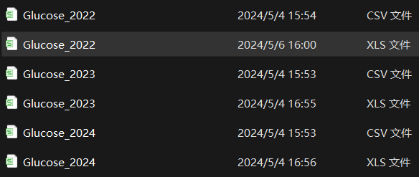
Task 1
I converted the data into XLS format and removed some irrelevant data, such as the device name, serial number and record type.
I only left the time and historic glucose (mmol/L) to illustrate the relationship clearly between the data.

Slide 24
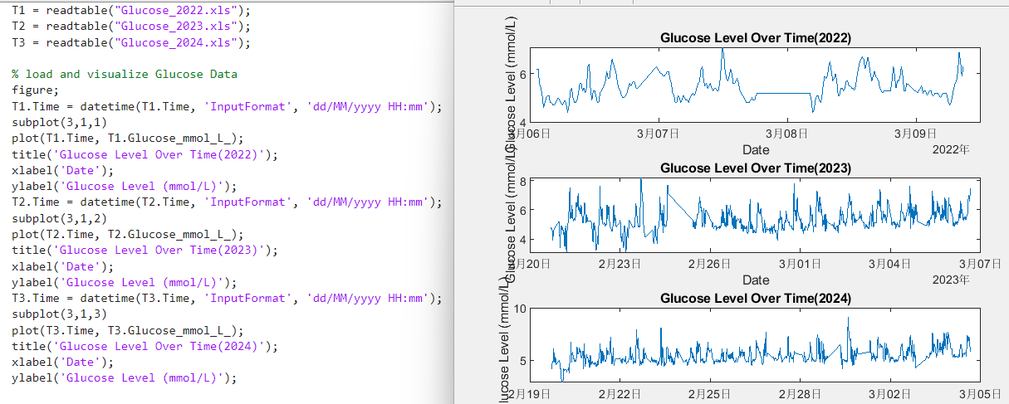
Task 1
Visualize the original data

Slide 25
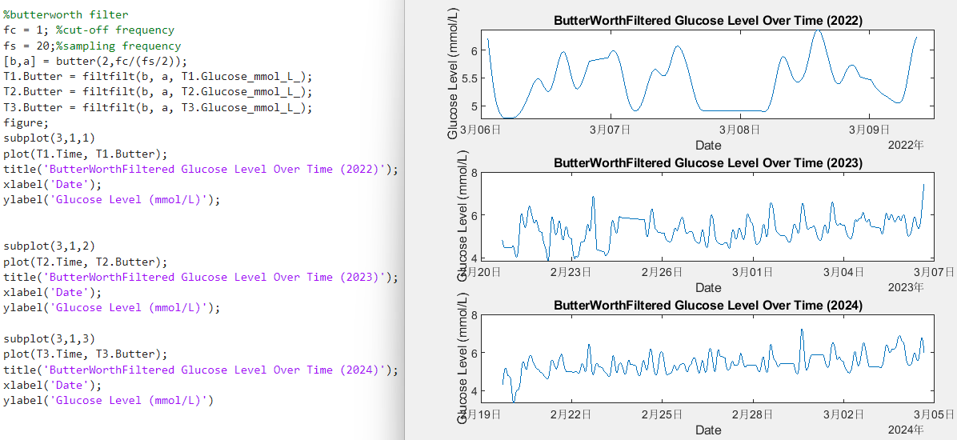
Task 1
Design a filter in Matlab to remove the high frequency noise

Slide 26
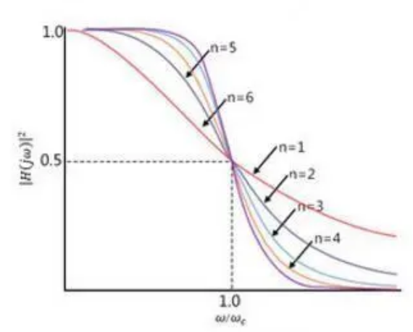
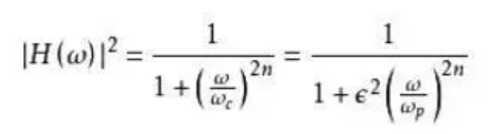
Task 2
The Butterworth filter has a notable feature for its "maximally flat magnitude response".
Figure2. Transfuction of Butterworth
Figure1. Amplitude frequency characteristics

Slide 27

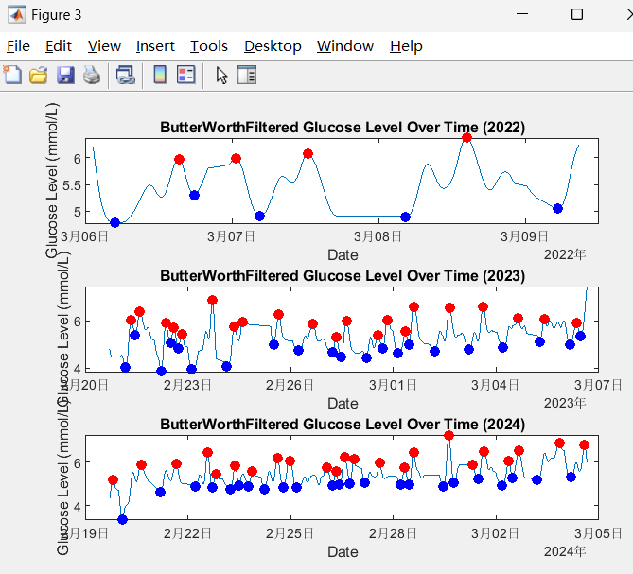
Task 3
Develop peak detection routines to automatically detect the high/low peaks in glucose

Slide 28
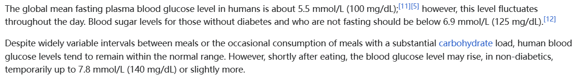
Task 4
Blood sugar level —— from wikipedia
In most cases, exercise can decrease blood glucose levels. When the body is active, muscles require more energy, typically derived from glucose in the blood and glycogen stored in the muscles.
Besides, sustained physical activity helps lower and stabilize blood glucose levels, reducing occurrences of hyperglycemia and hypoglycemia.

